Slide 1
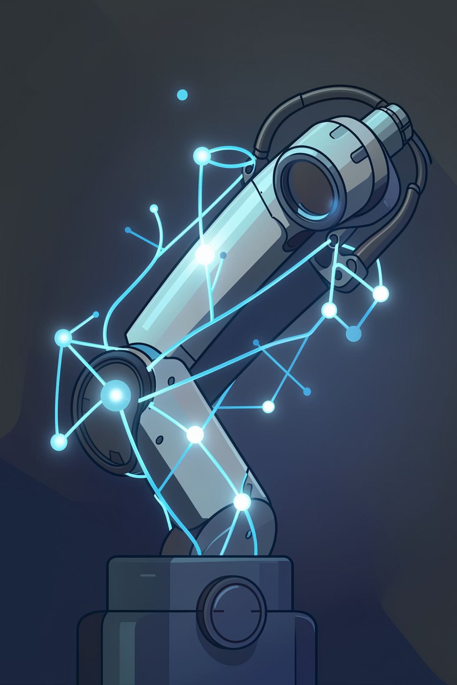
EEG-Based Brain–Computer Interface for Assistive Robotic Arm Control
A non-invasive BCI system leveraging motor imagery EEG signals to enable real-time control of a robotic arm for individuals with motor impairments.
Team Members
Prajwal Dikonda - 22516691
Nishant Shetty - 22566540
Papiha Dhavan - 22514341
Course
Master's - Assistive Robotics

Slide 2
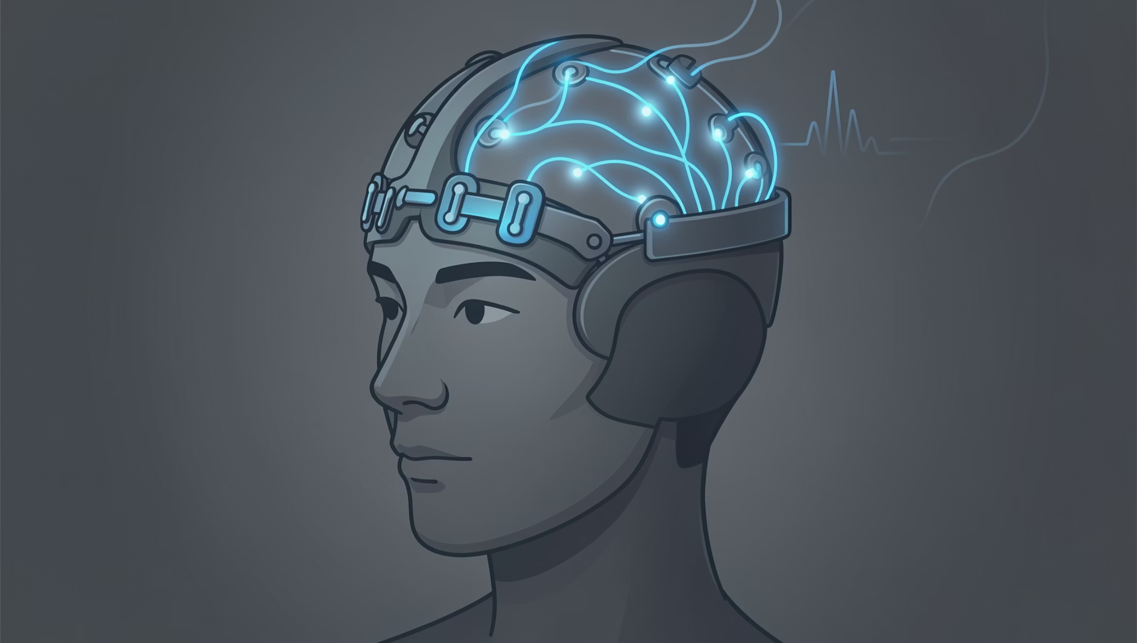
Brain–Computer Interfaces: A Primer
What is a BCI?
A BCI establishes a direct communication channel between the brain and an external device, interpreting neural activity as control commands — no peripheral nerves or muscles are required.
Invasive vs. Non-Invasive
EEG is chosen for its accessibility and real-world deployability without requiring surgical intervention.
Invasive (ECoG / Implants)
Non-Invasive (EEG) ✓
High signal resolution, surgical risk, limited clinical adoption
Safe, portable, cost-effective, millisecond temporal resolution

Slide 3
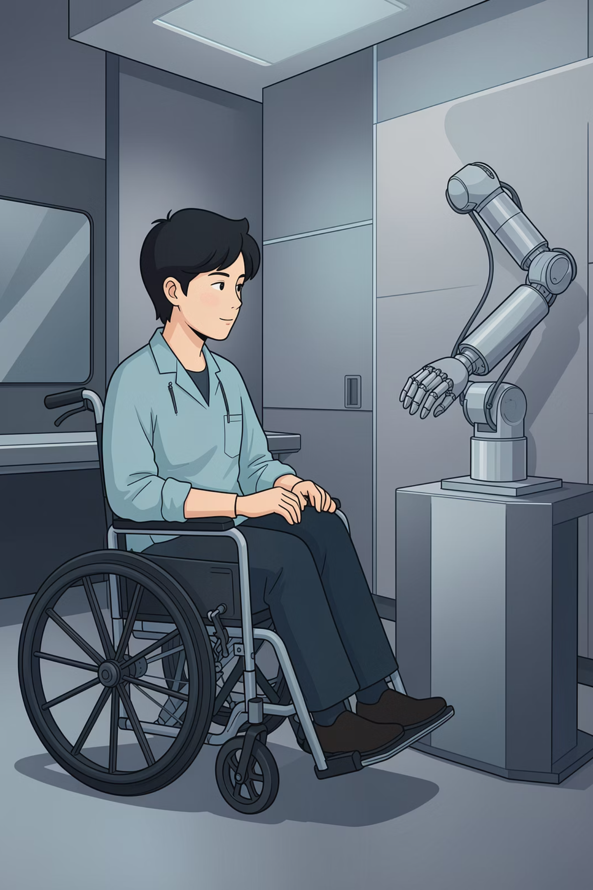
The Problem: Motor Impairment & the Assistive Gap
15M
5.4M
Annual Strokes
Stroke Survivors
People affected globally each year, many with lasting motor disabilities
Living with paralysis or significant limb impairment in the U.S. alone
1B+
Disabled Worldwide
People with some form of disability, about 10% involving motor function loss
Conventional assistive devices require residual limb movement, excluding patients with complete upper-limb paralysis. A direct neural interface bypasses the motor pathway entirely, restoring functional independence without physical input.

Slide 4
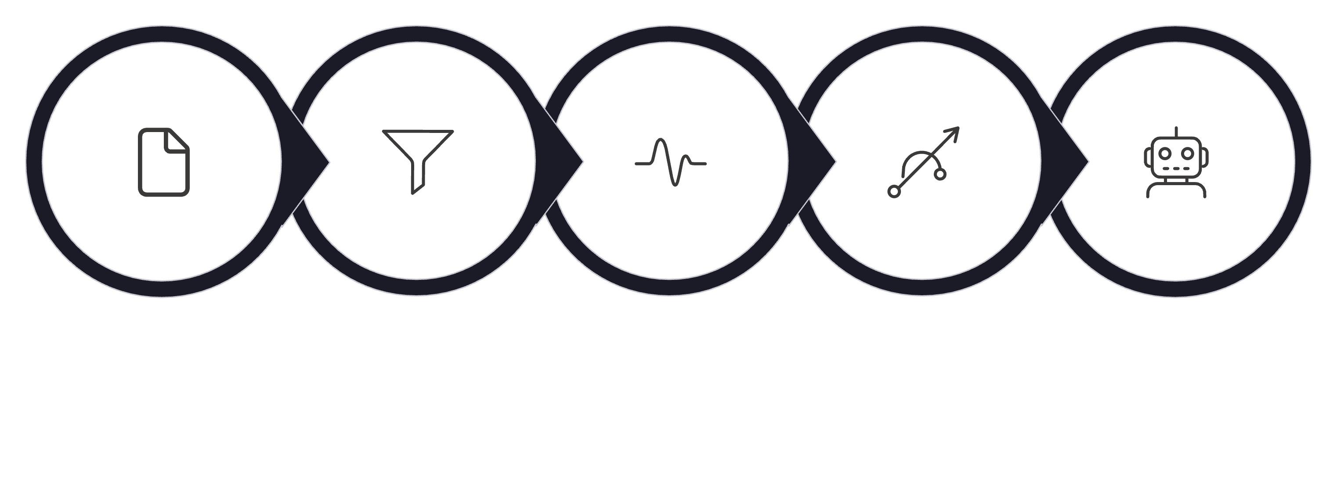
System Architecture
END-TO-END PIPELINE
Signal Preprocessing
EEG Acquisition
Feature Extraction
Classification (SVM)
Robotic Arm Control
Hardware Layer
Software Layer
16-channel EEG amplifier (OpenBCI / g.tec)
Electrodes at C3, Cz, and C4 (sensorimotor focus)
250 Hz sampling rate, 24-bit resolution
Python pipeline: MNE, SciPy, Scikit-learn
ROS 2 for robot command communication
Gazebo / PyBullet simulation environment

Slide 5
Methodology: Feature Extraction & Classification
Feature Extraction
Why SVM over Deep Learning?
Small dataset: Typical MI sessions yield ~200–400 labelled epochs — insufficient for reliable deep learning generalisation
Interpretability: SVM margins and support vectors are mathematically transparent — critical for clinical validation
CSP — Common Spatial Patterns
PSD — Power Spectral Density
Learns spatial filters maximising the variance ratio between two classes. Produces discriminative spatial components from multi-channel EEG.
Quantifies band power (mu, beta) per channel via Welch's method. Captures ERD/ERS magnitude as a compact feature vector.
Latency: SVM inference is sub-millisecond on a standard CPU, meeting real-time control constraints

Slide 6
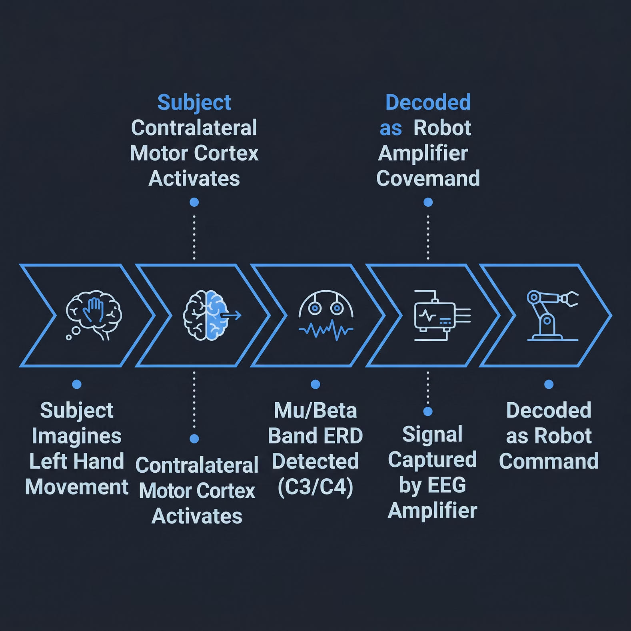


Motor Imagery: Thinking as Control
The Neuroscience
When a subject imagines moving their left or right hand, event-related desynchronization (ERD) and synchronization (ERS) occur in the contralateral sensorimotor cortex—detectable as power changes in the mu (8–12 Hz) and beta (13–30 Hz) bands.
Crucially, these signals are present without any physical movement, making motor imagery ideal for users with paralysis.
Mu and beta rhythms suppress during imagined movement—this spectral signature is the core discriminative feature used for classification.

Slide 7
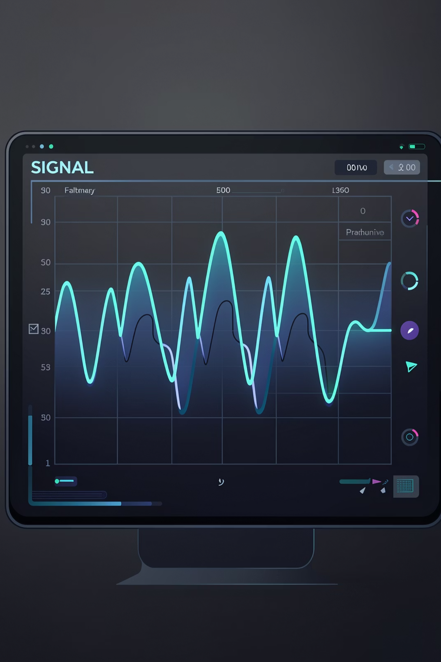
Methodology: Signal Processing
Band-Pass Filter (8–30 Hz)
Isolates the mu and beta rhythms relevant to motor imagery. A 4th-order Butterworth filter preserves phase integrity while attenuating DC drift and high-frequency muscle artefacts.
Notch Filter (50 Hz)
Suppresses power-line interference, the dominant environmental noise source in laboratory settings. Applied before the band-pass filter to prevent artefacts from aliasing into the signal band.
Artefact Rejection
Epochs contaminated by eye blinks (>100 µV) or muscle noise are automatically rejected using amplitude thresholding prior to feature extraction.

Slide 8
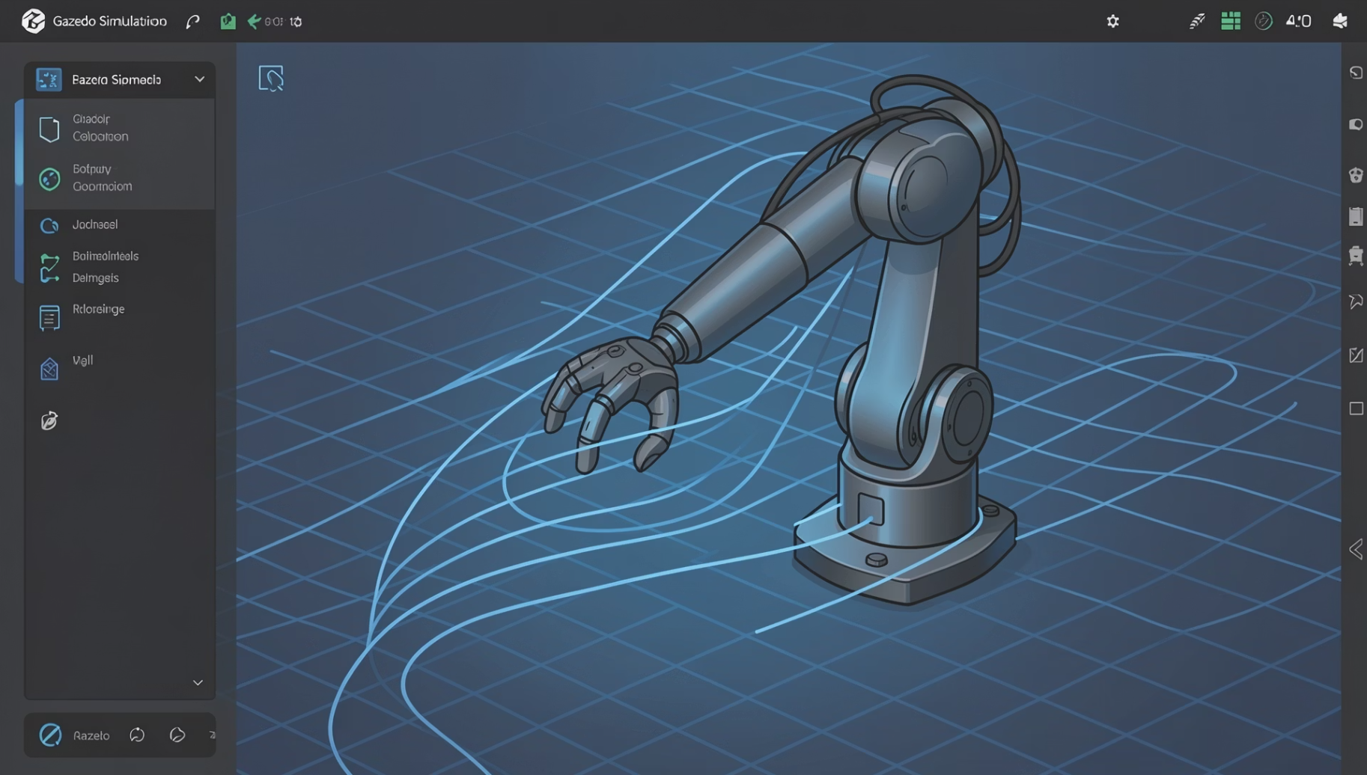

Simulation & Implementation
Simulation Environment
A 6-DOF robotic arm model (URDF) is deployed in Gazebo and PyBullet for safe, repeatable testing before hardware deployment.
ROS 2 Integration
BCI classifier publishes commands on a ROS 2 topic
MoveIt! translates class labels into joint trajectories
The feedback loop confirms task completion state
Simulation decouples software validation from hardware availability, significantly accelerating iteration cycles.

Slide 9
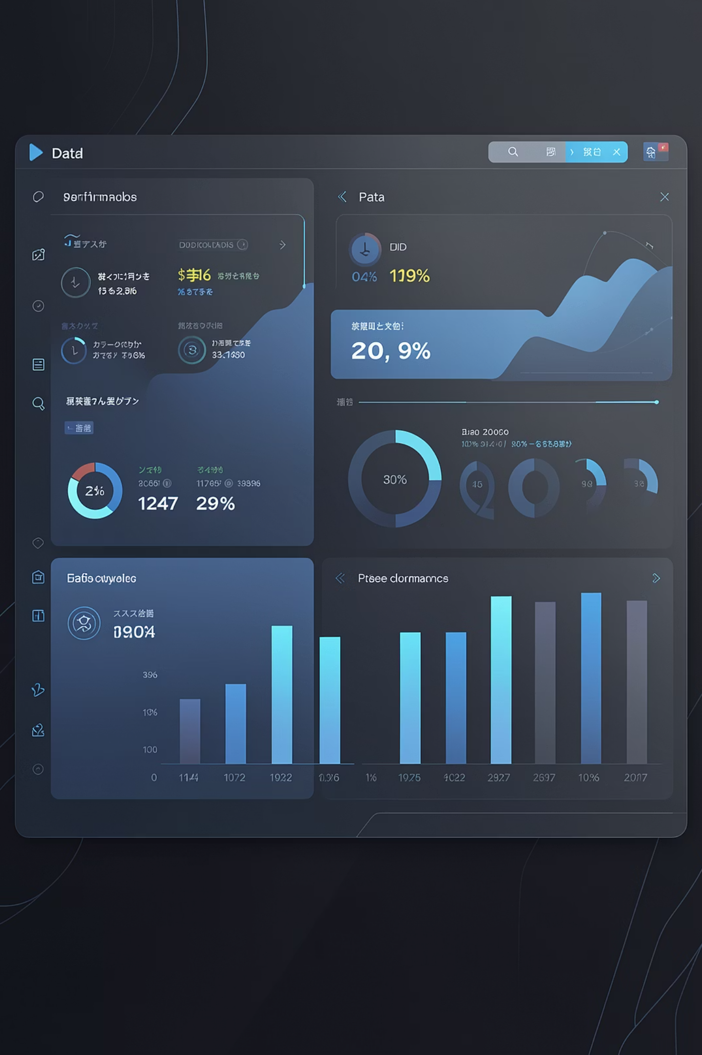
Results & Key Performance Indicators
82%
Classification Accuracy
Averaged across subjects on left- and right-hand motor imagery (2-class)
180ms
End-to-End Latency
From EEG epoch end to robot joint command issuance via ROS 2
91%
Command Success Rate
Correct arm motion executed per decoded intent in simulation trials
4
Motion Classes
Left, right, grasp, and rest — covering the primary assistive interaction tasks
Results demonstrate that the CSP + SVM pipeline achieves clinically viable accuracy with latencies well within the 300 ms real-time threshold established in assistive BCI literature.

Slide 10
Conclusion & Future Work
Key Contributions
Future Directions
1
Designed a full EEG-to-robot pipeline using motor imagery with 82% classification accuracy
Real hardware deployment on a physical 6-DOF robotic arm
Subject-adaptive models using transfer learning to reduce calibration time
Expanded command set with multi-class MI (feet, tongue) for richer control
Hybrid BCI fusing EEG with EMG for redundancy and robustness
Closed-loop feedback via haptic or visual confirmation for user confidence
2
Validated in simulation (Gazebo/PyBullet) with ROS 2 integration, achieving 91% command success
3
Demonstrated SVM viability as a lightweight, interpretable classifier for real-time BCI

